Slide 1
January, 2020
Deep Learning
Overview

Slide 2
What is Deep Learning?
Do I need it?
“Deep Learning” are modern methods of creating Machine Learning Systems.
They use “Artificial Neural Networks”.
Machine Learning Systems = Prediction Machines.
Computers make computations cheap.
Computers make predictions practical – fast and cheap.

Slide 3
Artificial General Intelligence (AGI)
AI that could successfully perform any intellectual task that a human can
(Turing test (1950), ...)
Artificial Intelligence (AI)
ML (DL) learning functions which are typically associated with human abilities (speech and music recognition, conversation, visual recognition, video prediction, reasoning, self-driving cars, playing games, etc.)
Deep Learning (DL)
ML implemented as Neural Network
Machine Learning (ML)
DS where algorithm learns from data and can do predictions
Data Science (DS)
computer skills + statistics
CSV files, SQL, PowerPoint

Slide 4
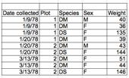



When do you need to train Deep Learning Models?
Most of Data Science tasks are based on Tabular Data and don't require Deep Learning.
Many of complex tasks were already solved and available for you on major clouds (Google Translate, Azure Cognitive Services, etc.) – although these solutions tend to be costly.
For some tasks when Deep Learning is needed, it can be prototyped very fast on major clouds using pre-trained models and transfer learning.
For cost savings, the Deep Learning models can be moved to a private cloud.

Slide 5
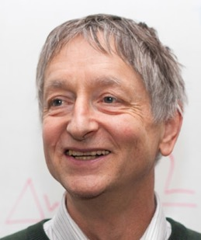
Three decades ago, Hinton was already making his mark on deep learning, co-inventing Boltzmann machines, backpropagation, and contrastive divergence.
But it wasn’t until the computing power managed to scale to meet the demands of deep learning that Hinton truly began to get the wider recognition outside of academia he deserved.
In 2004, he co-founded Neural Computation and Adaptive Perception, a handpicked, invite-only group of researchers from across the fields of physics, neuroscience and engineering.
He also founded DNNResearch, which was acquired by Google.
Since then, he’s been working on the Google “Brain” neural network project, and helping to dramatically improve Google’s image recognition and Android’s audio recognition capabilities.
Geoffrey Hinton
University of Toronto & Google
- https://en.wikipedia.org/wiki/Geoffrey_Hinton

Slide 6
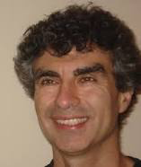
Yoshua Bengio
Full Professor, head of the Montreal Institute for Learning Algorithms. Most noted for his work on artificial neural networks and deep learning.
- https://en.wikipedia.org/wiki/Yoshua_Bengio
- http://www.iro.umontreal.ca/~bengioy/yoshua_en/
- https://scholar.google.com/citations?user=kukA0LcAAAAJ
Very good pictorial tutorial:
- http://www.iro.umontreal.ca/~bengioy/talks/DL-Tutorial-NIPS2015.pdf

Slide 7
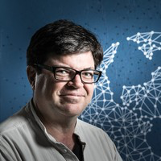
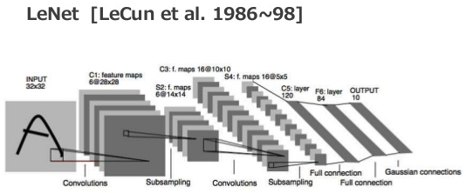
Yann LeCun (NYU, FB)
Credited with inventing Convolutional Neural Networks
in his 1998 paper on LeNets
https://www.youtube.com/watch?v=IbjF5VjniVE

Slide 8
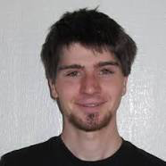
Generative Adversarial Networks (GANs)
Police Detective
(recognizes images)
Artistic Criminal
(generates fake images)
Both Detective and Criminal receive same set of images
(for example, pictures of cats and dogs).
Criminal randomly generates “fake” images
(cat with 6 legs and two tails, etc.).
Detective learns to discriminate real images from fakes
and becomes better and better.
Criminal learns to make better and better fakes.
Adversarial relationship helps both become better very fast.
Ian Goodfellow
Staff Research Scientist at Google
Student of Yoshua Bengio.
https://en.wikipedia.org/wiki/Ian_Goodfellow
Generative Adversarial Nets (2014)
https://arxiv.org/pdf/1406.2661v1.pdf
Examples of fake faces:
- https://thispersondoesnotexist.com/

Slide 9
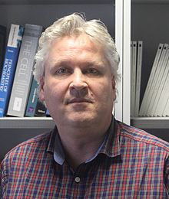
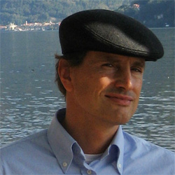
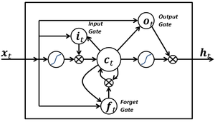
A simple LSTM block with only input, output, and forget gates. LSTM blocks may have more gates.
Sepp Hochreiter, Austria
- http://www.bioinf.jku.at/people/hochreiter/
Jürgen Schmidhuber, Switzerland
- http://people.idsia.ch/~juergen/
LSTM - Long short-term memory (1997)
https://en.wikipedia.org/wiki/Long_short-term_memory
Imagine Recurrent Neural Network trying to recognize music sampled at 44KHz.
The 10 sec phrase will be 440,000 points. How do we do back propagation through so many points?
This is the exploding or vanishing gradient problem.
Solution - instead of propagating analog gradients backwards,
we use "gates" (all or nothing).

Slide 10
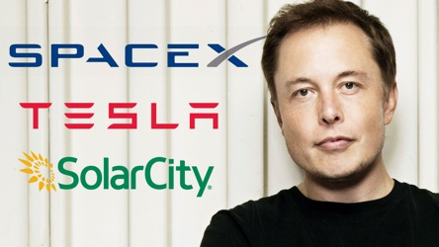

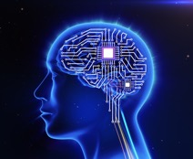
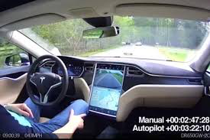

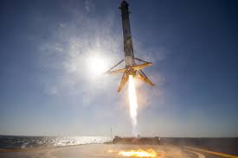
Elon Musk
PayPal
Tesla (self-driving electric cars)
SpaceX (Space ships
Open AI (open source AI)
Neurolink (integrate the human brain with AI – implantable interfaces)
Hyperloop - high-speed transportation system - reduced-pressure tubes, linear induction motors and air compressors.
The Boring Company – to dig tunnels.

Slide 11

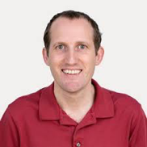
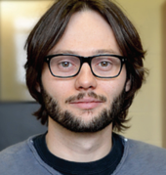
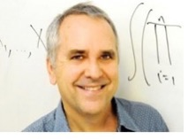
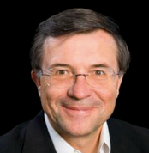
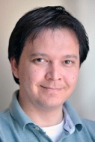
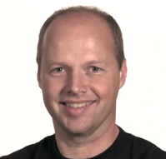
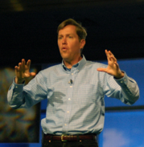
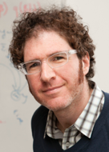
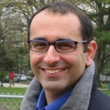
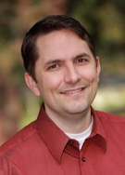
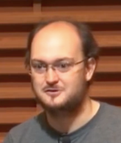
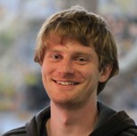


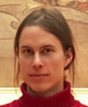
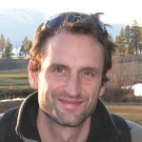

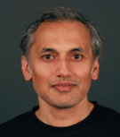
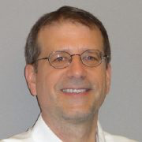
Michael I Jordan
Andrej Karpathy
Vincent Vanhoucke
Hugo Larochelle
Terry Sejnowski
Ruslan Salakhutdinov
Richard Socher
Sebastian Thrun
Jeffrey Hawkins
David M. Blei
Zoubin Ghahramani
Adam Coates
Pascal Lamblin
John Schulman
Alex Wiltschko
Tomas Mikolov
Alex Graves
Marc'Aurelio Ranzato
Shubho Sengupta
James D.
McCaffrey

Slide 12
Some People to Follow (on Facebook, Twitter)
Yann LeCun
Geoffrey Hinton
Ian Goodfellow
Yoshua Bengio
Jürgen Schmidhuber
Sam Charrington – podcast “This Week in Machine Learning & AI”
Chris Olah - - http://colah.github.io/ - - http://distill.pub –
Siraj Raval – on youtube (despite his plagiarism, … )

Slide 13
Deep Learning – models implemented as Neural Networks
Rectifier Leaky Rectifier
As neuron input grows, neuron activates (starts firing).
In NN it is modeled by "Activation Function".
Most commonly used function is "Rectifier".
ReLU = Rectified Linear Unit

Slide 14
Deep Learning - start from 1-layer shallow function aproximation
0..1
y = f(x)
x
1..2
2..3
3..4
if x in (0,1) :
y = x*k1
elif x in (1,2) y = x*k2
elif x in …
Complexity of the above function is 4 points (“weights”).
But what if the complexity requires … billions of points?
Imagine that the input is not a single variable, but colored pictures or video clips ...

Slide 15
Chess board “multiplicative” complexity
1
2
4
8
…
N_{k} = 2*N_{k-1}
2⁶⁴ ~ 10¹⁹

Slide 16
Deep Learning – using layers to achieve “multiplicative” complexity
x
y = f(x)
If sequential layers are fully interconnected, then number of connections ~N*N*(L-1), and complexity ~ N^{L-1}, (N = size, L = number of layers). So if N=L=20, then Ncon =~ 8,000, Ncompl =~20¹⁹ =~ 5*10²⁴ .
Note: Logic is stored in weights of connections (W-coefficients), and biases (b-shifts). Note: we need non-linearity in nodes, otherwise the network is equivalent to a simple linear function.

Slide 17
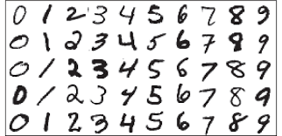
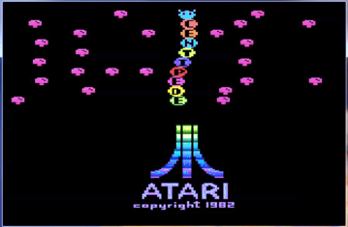
Supervised Learning
Data is labeled - it consists of tuples (input, label).
Learning – find parameters (W-s & b-s) which approximate
correct outputs (labels) for given inputs
Example – MNIST database of hand-written digits used to
train networks to recognize numbers.
Unsupervised Learning
No labels.
Learn the probability distribution p(x), or some interesting
properties of that distribution. Classify (figure out labels).
Example – Google universal translator
Reinforcement Learning
Feedback is not provided for every step, but only for final result.
Examples – learning to win in games (Atari, Go), robotics, etc.
"Good Puppy ..." reinforcement

Slide 18
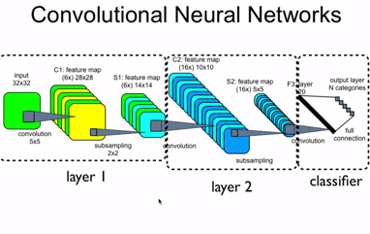
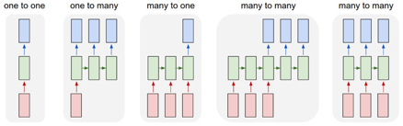

Examples of network architectures:
Feed-Forward Network
Deep Belief Network
(many layers of Restricted Boltzmann Machines (RBMs)
Convolutional Neural Network (CNN)
Recurrent Neural Network (RNN)
Autoencoders
Generative Adversarial Network (GAN)
Reinforcement Learning
Etc. Etc.

Slide 19
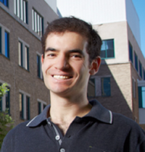
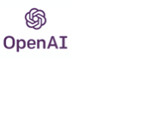
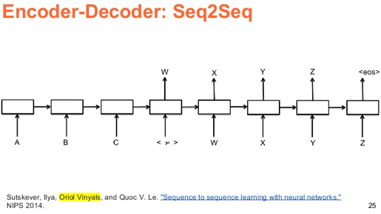
Ilya Sutskever
ilyasu@openai.com
Co-founder and Research Director of OpenAI.
Past: 3 years at Google Brain Team.
Co-author of AlexNet Co-founder of DNNresearch. a postdoc in Stanford with Andrew Ng's group. a student of Geoffrey Hinton, Toronto.
- https://blog.openai.com/evolution-strategies/ - (2017) Evolution Strategies (ES) – simpler and allow parallelization - thus better than Reinforcement Learning (RL)
Sequence to sequence learning

Slide 20
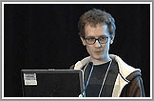
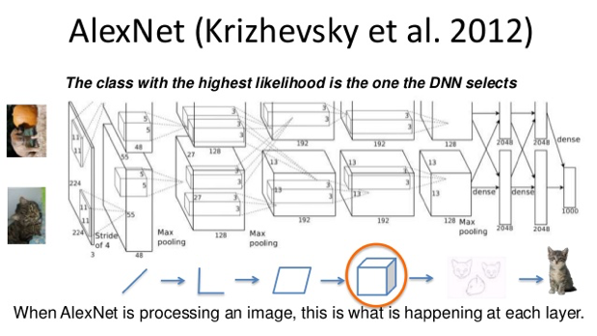
Alex Krizhevsky
- Convolutional network - Used GPUs - Used ReLUs - Used Drop Out to reduce ‘overfitting’ (DropOut).
Now at Google AlexNet – re-implemented LeNet on GPU (Toronto),
won 2012 ImageNet competition
“ImageNet Classification with Deep Convolutional Networks” - Alex Krizhevsky, Ilya Sutskever, and Geoffrey Hinton https://papers.nips.cc/paper/4824-imagenet-classification-with-deep-convolutional-neural-networks.pdf

Slide 21

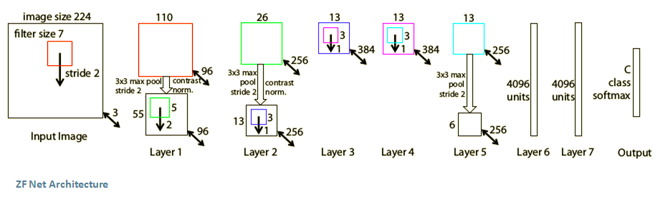
ZF Net
The ILSVRC 2013 winner was a Convolutional Network
from Matthew Zeiler and Rob Fergus.
ZFNet (Zeiler & Fergus Net).
It was an improvement on AlexNet by tweaking the architecture hyperparameters,
in particular by expanding the size of the middle convolutional layers
and making the stride and filter size on the first layer smaller.
Matthew Zeiler
New York, clarifai - uses ML/DL for object recognition and search (ads, images, photo collections).
DL networks, Computer Vision, CS Ph.D. at NYU

Slide 22
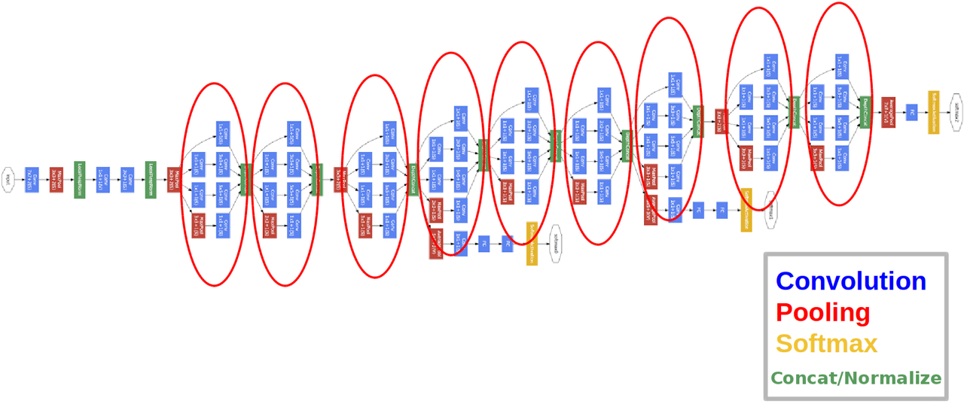
GoogLeNet (2014) - 22 layer CNN and was the winner of ILSVRC 2014
http://www.cv-foundation.org/openaccess/content_cvpr_2015/papers/Szegedy_Going_Deeper_With_2015_CVPR_paper.pdf
Christian Szegedy, Wei Liu, Yangqing Jia, Pierre Sermanet, Scott Reed,
Dragomir Anguelov, Dumitru Erhan, Vincent Vanhoucke, Andrew Rabinovich
Inception module -> convolution and pooling in parallel.

Slide 23
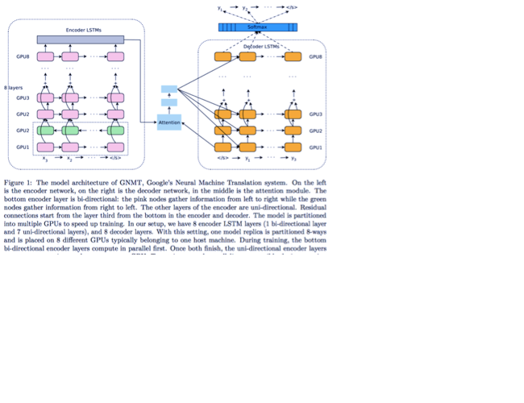
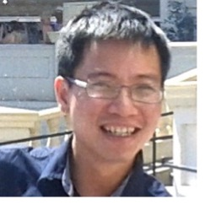
Quoc Le qvl@google.com
Google
GNMT (2016, Google Neural Machine Translation). Past: PhD Student – under Andrew Ng, Stanford
http://cs.stanford.edu/~quocle/ - papers, tutorials
https://arxiv.org/pdf/1609.08144v2.pdf - 31 authors deep LSTM network 8 encoder and 8 decoder layers parallelism - decreasing training time using attention and residual connections attention mechanism - connects the bottom layer of the decoder to the top layer of the encoder low-precision arithmetic for inference computations

Slide 24

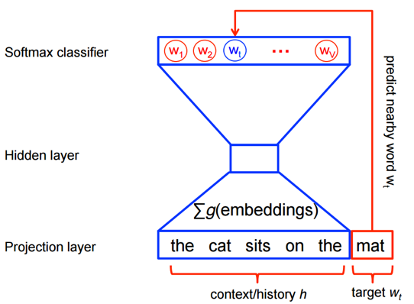
Word2vec (Mikolov et al)
word2vec is a two-layer neural net that processes text and creates numeric vectors to represent words.
Main idea - a word can be described by its “neighbors”, by a company this word has. Similar words tend to have similar neighbors (word embeddings).
The network input is a text corpus and its output is a set of vectors of real numbers (typically in ~100 dimensional space).
The words with similar meaning tend to have vectors which are close to each other. We can even do vector arithmetic on them:
”king” – “he” + “she” ~ “queen”
Tomas
Mikolov

Slide 25
Word2vec - a group of models that tries to represent each
word in a large text as a vector in a space of N dimensions
(which we will call features)
making similar words also be close to each other.
V(King) – V(Man) + V(Woman) ~ V(Queen)
Tomas Mikolov published word2vec in 2013.
Note – there are many models in other areas working as “Something-to-vec”, for example: - Node2Vec - node2vec is an algorithmic framework for representational learning on graphs (given any graph, it can learn continuous feature representations for the nodes).
- Dna2vec - vector representations of variable-length k-mers (in long DNA sequence).

Slide 26
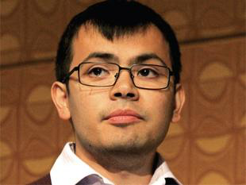
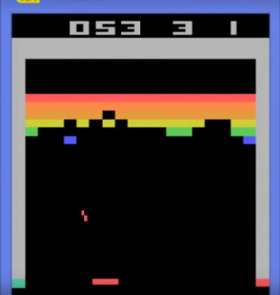
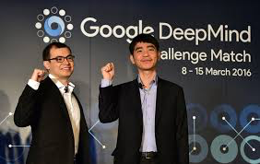
(Deep) Reinforcement Learning
Generative models
AlphaGo playing with itself
Self-driving car driving in virtual world
Atari games
Demis Hassabis
Demis Hassabis CEO of Google DeepMind (>700 people). Co-founded DeepMind in 2010, sold it to Google in 2014.
Videogames designer, AI programmer
- http://demishassabis.com
- https://en.wikipedia.org/wiki/Demis_Hassabis
- 2013 – Atari games, reinforcement learning
- https://arxiv.org/pdf/1312.5602v1.pdf
- 2016 – AlphaGo (2017 – AlphaGo Zero)
- https://en.wikipedia.org/wiki/AlphaGo
AlphaGo

Slide 27

Training Neural Networks
Forward propagation – from input to output (inference).
Error - compare output with label (desired output).
Back-propagation to adjust weights and biases to reduce error (Gradient Descent).
Learning = optimizing parameters (weights, biases, etc.) to find (local) minimum within multi-dimensional space.
Simulated annealing.
Absolute minimum is computationally difficult to find. Local minimum or saddle point is usually enough.
To find minimum we use SGD (Stochastic Gradient Descent) or mini-batch GD.

Slide 28
Training Neural Networks – slide 2
Hyper-parameters (number of layers, size of layers, etc.).
Learning rate.
Data sets: training set, dev. set, testing set
Overfitting – good results on training set, but not as good on testing set.
Regularization methods, dropout, early stopping, etc.

Slide 29
Training Neural Networks – slide 3
Layer-to-layer – matrix multiplications
Tensor – multi-dimensional matrix
Most common frameworks/libraries:
TensorFlow (Google) + Keras
pyTorch (Facebook)
sklearn ( Scikit-Learn )
NLTK (Natural Language ToolKit)
Many others:
Theano (end of life), Lasagne (on top of Theano), Caffe, DSSTNE, mxnet, DL4J, CNTK (Cognitive Toolkit, Microsoft), ...

Slide 30
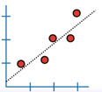
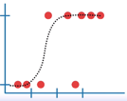
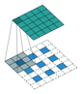
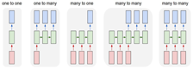
Coming up in next sessions:
Linear Regression, training as solving optimization problem
Classification Models (Logistic Regression, Trees, etc.)
CNNs (Convolutional Neural Networks) - images
RNNs (Recurrent Neural Networks) - sequences
Generative Models
Reinforcement Learning

Slide 31




NIPS = NeurIPS = Neural Information Processing Systems
NIPS Conference
was held every December since 1987
- https://nips.cc
- https://papers.nips.cc
Wikipedia:
- https://en.wikipedia.org/wiki/Conference_on_Neural_Information_Processing_Systems
Ed Posner,
CalTech,
First conference
President, founded NIPS foundation.
Yaser Abu-Mostafa,
CalTech
James Bower
CalTech,
now Virtual Worlds, OR
1987-2000 – in Denver, USA
2001-2010 – in Vancouver, Canada
2011 – Granada, Spain
2012-2013 – Lake Tahoe, US
2014-2015 – Montreal, Canada
2016 - Barcelona, Spain
2017 - Long Beach, California, US (Dec 4-9)
2018 - Montréal, Quebec, Canada
2019 - Dec 8-14, Vancouver, Canada
2020 – Dec 6-12, online only
2021 – Dec 6-14 – online only
2014 – 2,500 registered participants
2015 – 3,755 (~50% growth)
2016 – 5,680 (~51% growth)
2017 – 8,000+
2018 – 12K (2K tickets for main session sold in 12 minutes) 2019 ~ 13K, lottery was used to distribute tickets
2020 - online
2021 - online

